Slide 1
The Invention Process: Step 3
Sketch It
Drawing Your Invention or Idea
Notes:
Step 3: Sketch It

Slide 2
Step 3: Sketch It
1
2
3
4
5
6
7
Notes:
In this lesson, you are going to learn how to complete the third step in the invention process, SKETCH IT, by drawing your invention idea.

Slide 3
Draw Your Invention Idea
You know that the word “sketch” simply means to draw. Not all inventors sketch at this stage, but by drawing your invention idea, you start to visualize what your invention will look like and how it will work.
Notes:
You know that the word “sketch” simply means to draw. Not all inventors sketch at this stage, but by drawing your invention idea, you start to visualize what your invention will look like and how it will work. It does not have to be a perfect drawing--a simple sketch is ok.

Slide 4
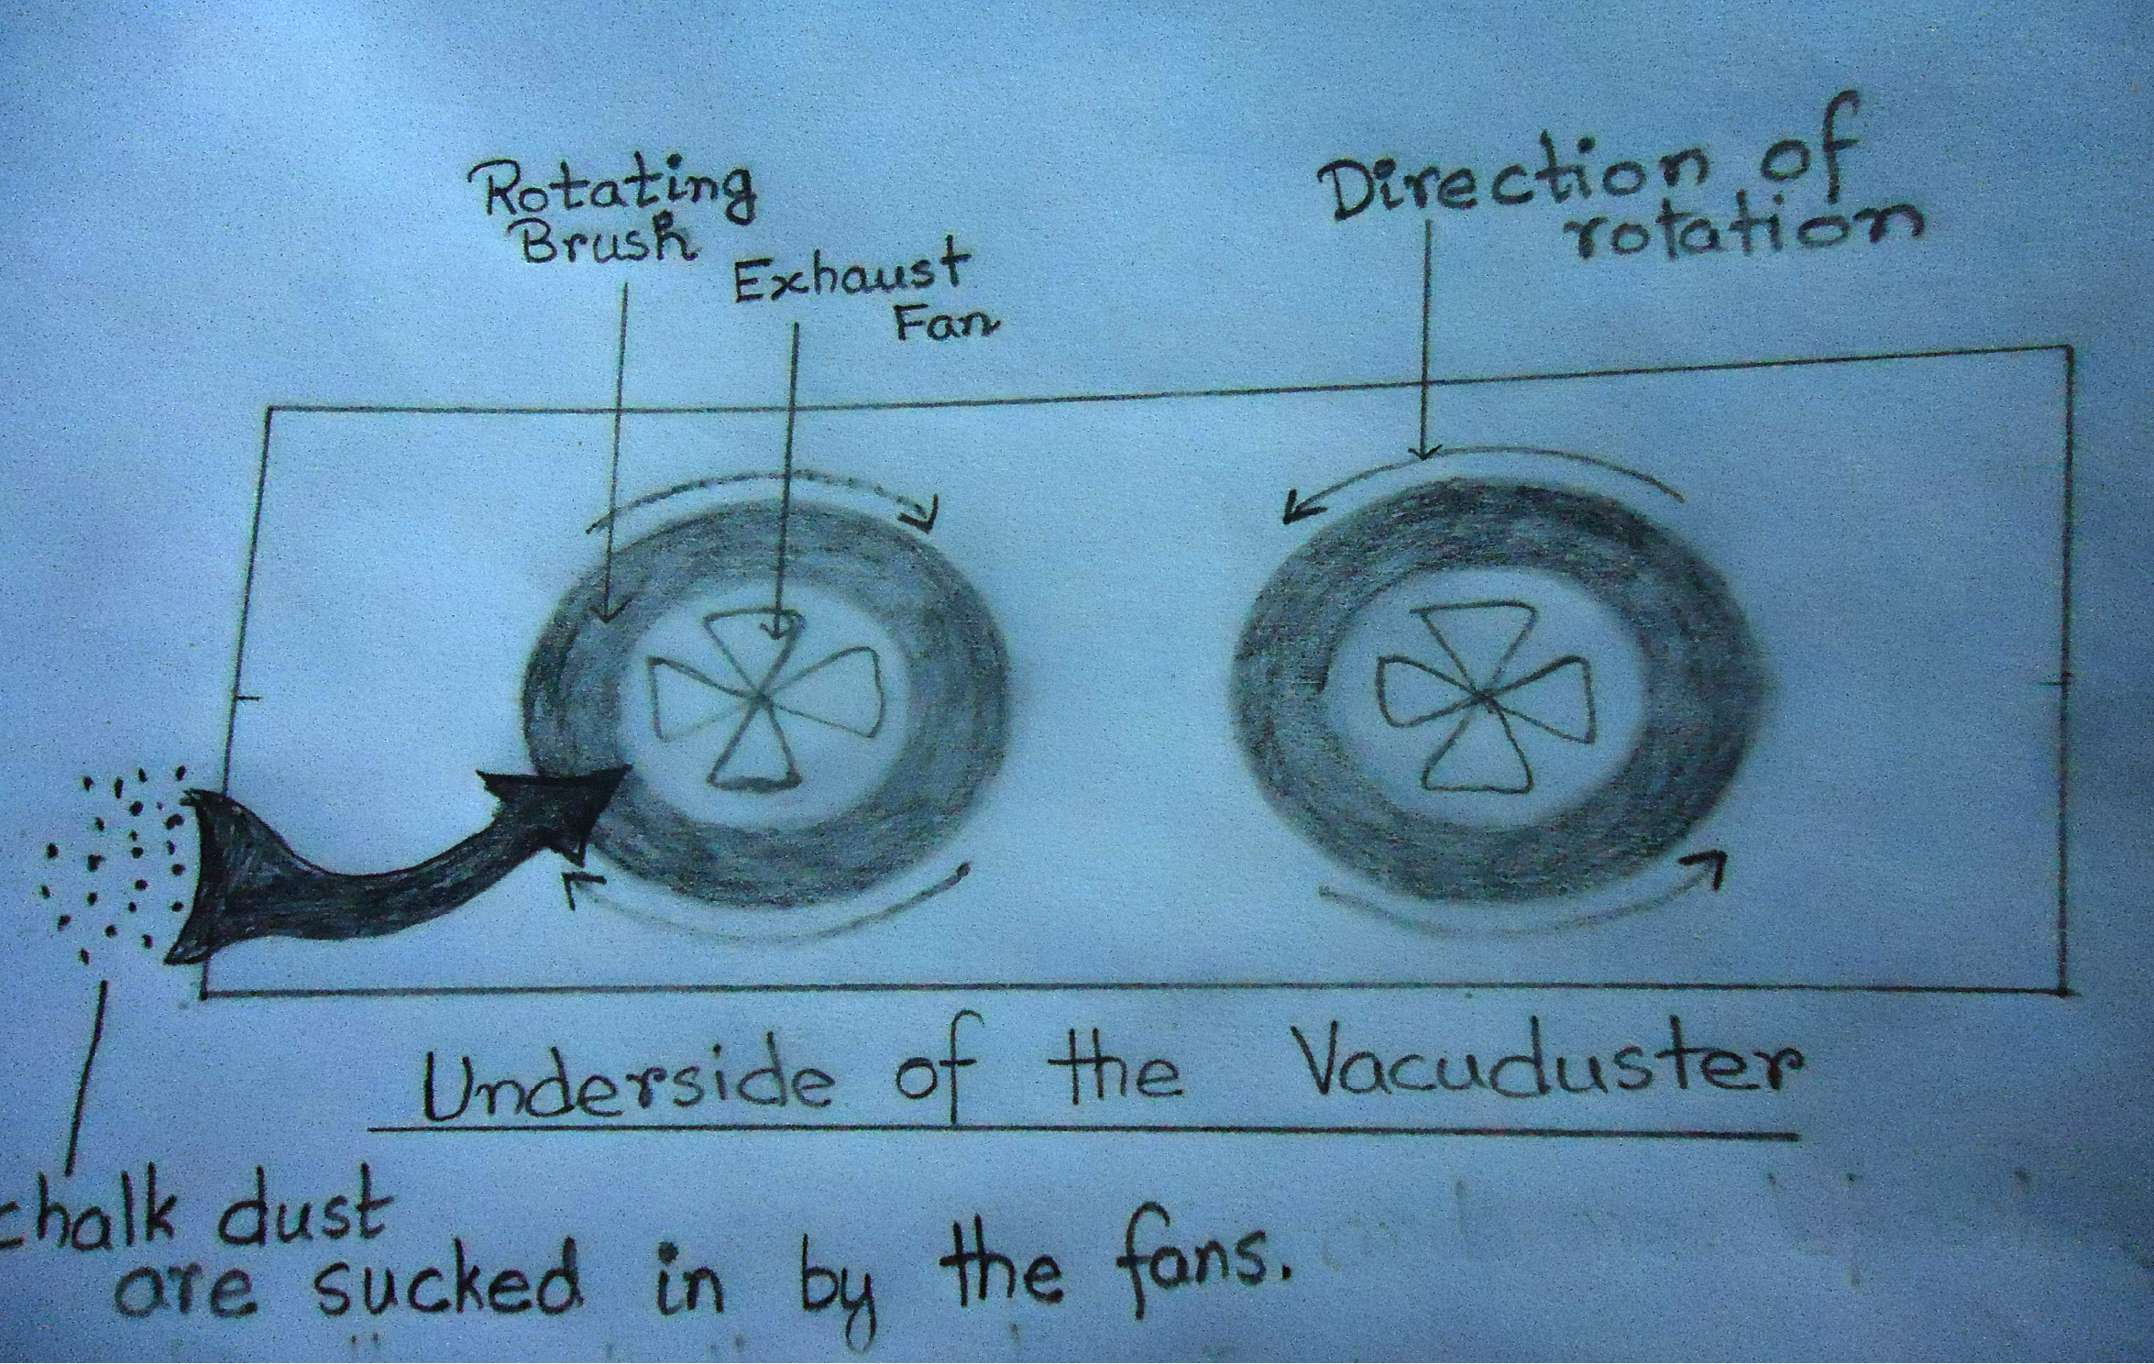
Draw Your Invention Ideas
Eighth grader Monimoy, from India, used a pencil and paper to sketch his idea. The labels really helped!
Monimoy G.
Kolkata, India
Notes:
In past Invent It Challenges, students like you have sketched in different ways.
8th grader Monimoy, from India, simply used a pencil and paper to sketch his idea for an chalkboard eraser that captures up the chalk dust. Notice how he labeled his sketch to explain how the various parts and pieces function.

Slide 5
Draw Your Invention Ideas
Ten-year old Hamsini, from Virginia, included many diagrams and explained what each one represented.
Hamsini R.
Virginia, USA
Notes:
Ten-year old Hamsini, from Virginia, used a pencil and paper as well as computer software to sketch his idea for a chemical pollutant sensor. Notice how he labeled his sketch to explain how the various parts and pieces function.

Slide 6
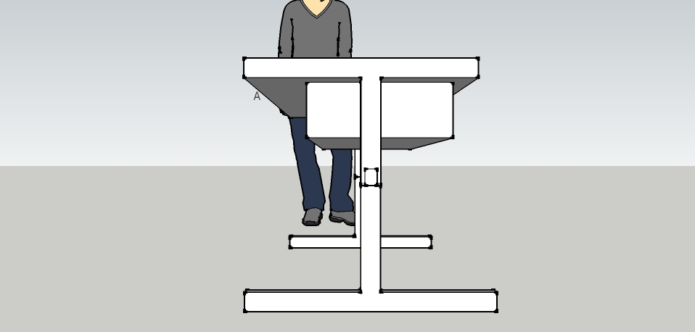
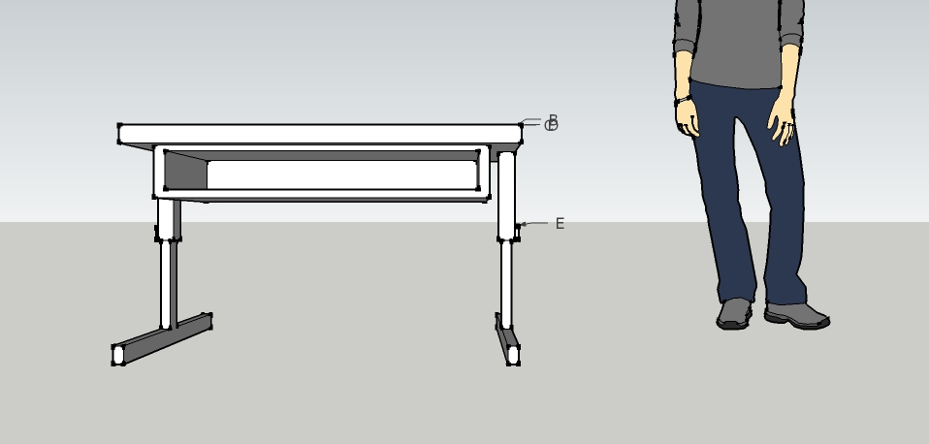
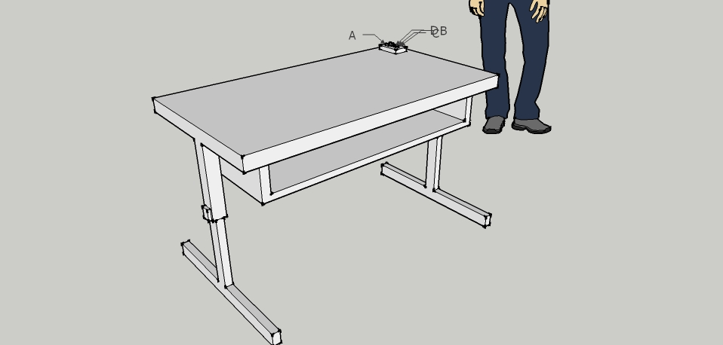
Draw Your Invention Ideas
A team of 10 year-olds, from California, used a computer aided design program to create a digital sketch of their idea for a desk. You may want to make several sketches of your invention – from the front, from the side, looking down from above, or from the inside--to show how it works.
Laila E., Angeli A., Mitzi C.,
California USA
Notes:
A team of 10 year olds used a computer aided design program to create a digital sketch of their idea for a desk. You may want to make several sketches of your invention – from the front, from the side, looking down from above, or from the inside--to show how it works.

Slide 7
Tips
Details make your sketch come to life.
Labels make your sketch clear.
Draw to scale.
Don’t limit yourself to one sketch!
Draw Your Invention Ideas
in your Notebook
Notes:
To sketch as an inventor, grab your Inventor’s Notebook (or computer) and get ready to draw!
Keep these tips in mind:
Details make your sketch come to life. The more details you put in your sketch, the clearer your invention idea becomes.
Labels make your sketch clear. Label not only the parts of your invention, but also what materials will be used to create the parts.
Draw to scale. Try to show the relative size of your invention in your drawing. You may want to include estimated measurements.
Don’t limit yourself to one sketch! It’s helpful to make different sketches as you evolve your idea and also to show the different sides of your invention.

Slide 8
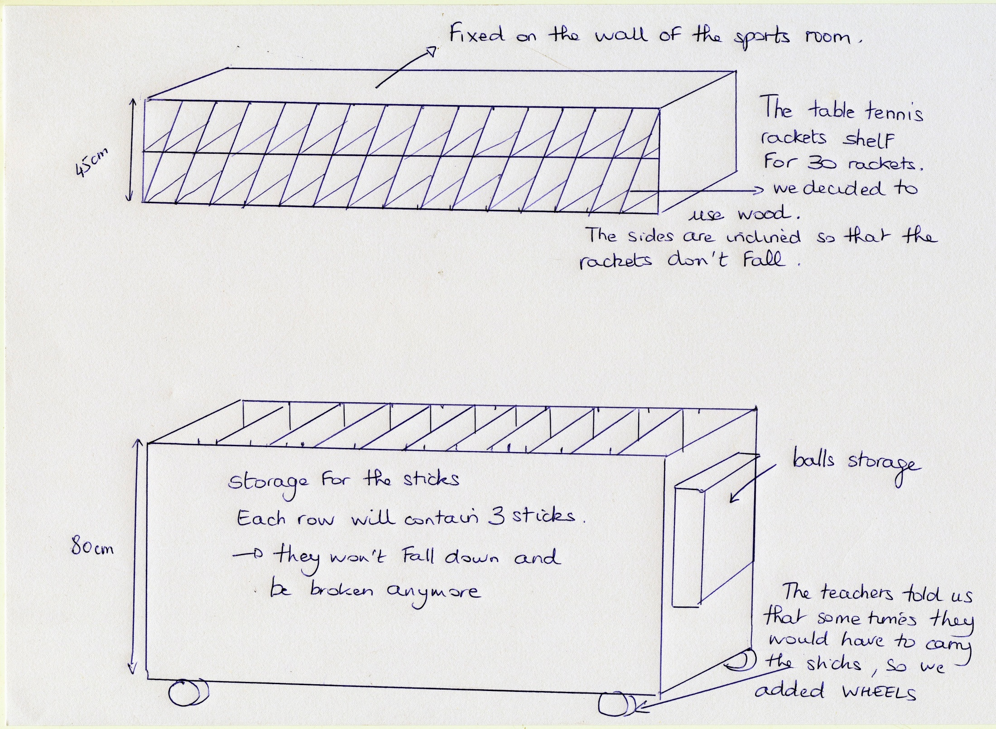
Create Your Visual Plan
Notes:
Get started right now by making a section in your Inventor’s Notebook titled Sketch It! Then, start drawing your ideas! This is your visual plan, so make sure it communicates your idea clearly.
Your notebook will help you when you prepare your entry for submission. Make sure the judges can see from your sketch that you thought deeply about your invention idea.

Slide 9
That’s the 3rd Step in the Invention Process.
Can’t wait to see your sketch!
Notes:
Now you know how to complete Step 3 of the invention process, SKETCH IT, by generating drawings that illustrate how you plan to solve a problem with a new invention!

